Slide 1
Contents
Advisory & Planning Section (reference only)
Contents
About this Document
Proposal Submission Plan / Checklist
MU Sign Off Accountability – planning tool
Solution Plan (template for population)
Solution Plan header page
Version Control
Top Sheet: Solution-to-Win and Price-to-Win
Opportunity Background
Competitor Strategy
Scope Definition
Delivery Approach Overview
Estimation Basis – Scope of Work
Effort Estimate & Staffing Pyramids
Indicative High-Level Schedule
Work Products & Deliverables
Expenses
Solution Blueprint
Payment / Contract Milestones
Key External Dependencies/Obligations
Key Risks
Key Assumptions
Pre-Contracting Action List
Opportunity QA Risk Assessment (Risk Profile)
Opportunity QA Risk Assessment (Solution Contingency)
CDP Risk Assessment
Project Organisation
Project Leadership & Critical Roles
Role and Responsibilities – Solution RACI
Assets and Tools
Appendix A: Supplementary Slides (examples: reference only)
Staffing & Effort Estimate by Week View – AEP
Mobilization Considerations/Lead Times
Infrastructure Requirements and Cost Elements
Scope - Estimating Basis
Key Workstream Tasks by Stage
Project Meetings Governance – Purpose & Rhythm
Sprint Meetings Governance – Purpose & Rhythm
Issue Escalation Procedure
Azure PSS Coverage
Deal Pricing Model
Appendix B: Associated Process & Policy (reference only)
Core Reference Materials
Core Policies
Fixed Fee Delivery Questions
Classifications and Document Control
Key: Solution Plan Template
Mandatory Slides for all opportunities
Optional Slides dependent on deal type
Slides that include ‘ETA slide’ in the footer are used in the ETA Template

Slide 2
About This Document
KEYNOTE: This slide is for internal reference only. You must remove this slide, instruction text boxes and sticky notes before the deal review.
IMPORTANT: Make sure to use the latest Solution Guide for the Offering or Technology of the deal being shaped. See Solution Guides page
What is the Solution Plan?
The purpose of Solution Planning is to define the solution and delivery approach that Avanade will provide to clients; this includes confirming scope, assessing capabilities and constraints, confirming the Solution Blueprint, and defining the Solution Delivery strategy.
The Solution Plan Overview (SP051) is a required work product to support DEEPR and will form the basis for Avanade’s client response on solution design. It presents the solution's story as to what the client has asked for, how we will deliver the scope, & why Avanade’s solution is differentiated.
The Solution Plan must bring together the key solution design metrics and challenge cost drivers, including GDN percentage, project staff levels, asset leverage, tool leverage, productivity gains and client scope assumptions, in order to commit to and deliver higher margins.
It is not expected that the SP051 is finalized at an early stage in the Solution Planning process, as it will be dependent on finalizing all associated aspects of the solution, but create an early draft supported by a pursuit plan, and keep it updated throughout the entire solution planning effort.
How You Should Use it:
As the Solution Architect, you are accountable for the completion of the SP051 and by signing-off you accept accountability for the solutions deliverability and bottom-line cost, as set out in the solution plan.
Initiate the Solution Planning process by ‘whiteboarding’ the client requirements and proposed solution with the pursuit team, to align understanding and approach to the solutioning & commercial activities.
Use the SP051 as a formal solution design document as part of the solution planning steps and inputs into the deal shape and contracting.
Ensure that the presented solution is consistent, tells the story, and is complete to ensure effective decision making during the sales process.
Where used to support client proposal responses, ensure all Avanade-internal instructions and notes are removed.
The SP051 template provides a standard framework for completion and review of Avanade solutions. Whilst certain slides are mandated, the Solution Architect may use discretion in the format of the information they chose to present.
When should you use it?
Guidelines for the use of the solution planning templates are:
When RBE = Accenture (Solutioning & Capability), use the ETA template.
When RBE = Avanade (Avanade End-to-End Accountability), use SP051 template.
When there is no estimate (Capability), no ETA or SP051 is required
Further Support:
See Solution Planning in ADF for more guidance.
Reach out to the Solution Architect Yammer community to seek input from the broader community
Use the latest Solution Guide for the Offering Solution Guides page
See Solutioning Portal for further information / links

Slide 3
Proposal Submission Plan / Checklist
REFERENCE
<State the target opportunity close date, and highlight additional core actions or activities outside of the table below>
Slide Purpose:
This slide is an example structure of a pursuit plan to support your solutioning efforts.
Instructions:
Replace this slide with your own pursuit plan overview
Populate all text formatted <like this>
Check Policy 5003 for the deal approval matrix criteria for your particularly opportunity, in consideration of its size ($) and complexity.
Delete this message upon completion
Deliverable | Owner | Completion Criteria | Status | Due Date
Solution Scope Definition | Solution Architect | Obtain from client business purpose, business requirements, scope definition etc. to support creating the technical solution, estimate etc. | <Not Started> | <dd-mm-yy>
Delivery Plan | Solution Architect | Methodology being applied, timeline, stages and deliverables per stage and sign off process | <Not Started> | <dd-mm-yy>
DCSO Approval | Solution Architect | Engage GDN solution architect and obtain approval | <Not Started> | <dd-mm-yy>
Business & Technical Solution | Solution Architect | Business Analysis and business deliverables reviewed by BA and Technical SMEs | <Not Started> | <dd-mm-yy>
AEM / AEP | Solution Architect | Completed AEP with alignment of scope to the business requirements | <Not Started> | <dd-mm-yy>
DPM/CTA | Deal Owner | Finance Reviewed | <Not Started> | <dd-mm-yy>
Client Data Protection | Deal Owner supported by SA | CDP Risk Assessments must be completed and approved in C365. See Data Management Policy 1431 | <Not Started> | <dd-mm-yy>
QA Risk Assessment | Solution Architect | Completed QA Risk Assessment ready for QAD Review. See QA Policy 0017. | <Not Started> | <dd-mm-yy>
QA Review | QA Director | Review to confirm mitigation plan, actions and Solution Contingency; include output in Solution Plan | <Not Started> | <dd-mm-yy>
Confirm Compliance | Deal Owner | Confirm all policies and legal requirements are met e.g. Export Compliance, Data Privacy and Protection. | <Not Started> | <dd-mm-yy>
Solution Plan (SP051) | Solution Architect | Completed Solution Plan (SP051) aligned with all other deliverables. Ensure that everything ‘ticks and ties’ between all artefacts | <Not Started> | <dd-mm-yy>
Write Proposal | Deal Owner | Proposal Document | <Not Started> | <dd-mm-yy>
Legal Review T&Cs | Legal | C365 Completed Approvals | <Not Started> | <dd-mm-yy>
MU Proposal Approval | Deal Owner | C365 Completed Approvals | <Not Started> | <dd-mm-yy>
Commercial Approval | Deal Owner | C365 Completed Approvals | <Not Started> | <dd-mm-yy>
Deliver Proposal | Deal Owner | Planned Client proposal submission | <Not Started> | <dd-mm-yy>
Deliver Contract | Deal Owner | Planned Client contract completion / signature | <Not Started> | <dd-mm-yy>
Sticky note to use during solutioning

Slide 4
MU Sign Off Accountability – planning tool
REFERENCE
Slide Purpose:
This slide provides for an overview of the core solution components that must be reviewed with the MU lead, or appropriate delegate, to solicit their support/approval of the proposed Solution Plan. This slide is not required for deal review, and is intended to provide a checklist of the key areas that must be discussed with the MU lead ahead of such review.
Instructions:
Populate all text formatted <like this>
Ensure all details are completed ahead of deal review.
Delete this message upon completion
Deal Area | Definition of Approval Criteria |  |  |  | Confirmed
DCSO | <Link to C365 for DCSO details> |  |  |  | <X>
Delivery Approach | <Agile, Waterfall, Hybrid, Notes> | ADF | <Methodology adherence Yes or No> |  | <X>
Outsourcing | <Yes / No> Refer to AO and IO Solution Plan Documents |  |  |  | <X>
Solution Guide | <Which guide was used in this solution> |  | <gaps in solution guide if any> |  | <X>
Solution Blueprint | Meets I&OS and MU Architectural Standards for solution integrity, fit to client requirements, maintainability, upgradability, performance, data privacy/protection and security standards with Data Protection by Design to Avanade Offerings. |  |  |  | <X>
Scope Estimate (AEP) | Estimates for defined scope meet the solution criteria, staffing guidelines and skills pyramid reflecting the risk profile and skills availability in region or GDN to deliver the deal as priced. |  |  |  | <X>
Functional Review | Functional scope aligns with client expectations, scope and expected contractual obligations. |  |  |  | <X>
Technical Review | Technical review with qualified architect knowledgeable in the offering has taken place and actions closed. |  |  |  | <X>
Pricing Model (DPM/CTA) | Finance case matches the solution plan, estimate and staffing profiles, risk profile, FX profile, at appropriate margins for Avanade MU Offering by market. |  |  |  | <X>
Assumptions (Solution Plan) | Assumptions in the Solution Plan are appropriate for the client expectations and to maintain solution, plan and effort integrity. |  |  |  | <X>
Risk Review | A QA Risk Assessment has been completed, if required and, mitigation plans are in place such that the overall risk aligns with Solution Contingency. | <QAD Name> | <QAD Name> | <Risk Level> | <X>
Deliverability | Solution is deliverable with Solution Blueprint standards at effort / duration estimates provided in client proposal. Confirm Deliverability at Margin sold. Consulted with appropriate assigned SA. |  |  |  | <X>
Proposal Alignment | Proposal Document aligns with Solution Blueprint, Solution Plan (SP051) and client RFP expectations. Exceptions have been mitigated through assumptions and scope statements. |  |  |  | <X>
Sticky note to use during solutioning

Slide 5
MANDATORY
Instructions:
Populate all text formatted <like this>
In completing the Solution Plan template ensure all “Mandatory slides” are completed; “Optional” slides can be used at the discretion of the Solution Architect, whom may also add ‘Supplementary’ slides where relevant.
Examples of Supplementary slides are included in Appendix A
Review instructions within each slide for guidance on how to complete the slide.
Ensure all ‘Sticky Notes’ have been addressed and removed, or detail specific actions pending completion, prior to Solution Review
Delete this message on completion
Solution Plan Overview (SP051) <Client Name> <Project Name>
<Version> <Date of Review> <C365 Reference>
Sticky note to use during solutioning

Slide 6
Version Control
MANDATORY
Slide Purpose: Used to track changes and completion of follow-on actions required to an existing version of the SP051, as determined through solution review, deal review or on the basis of Client interactions..
Use this slide to keep track of changes within the SPO51. Deal reviews and associated approvals should apply to a specific version of the SP051 as referenced in this slide.
Instructions:
Do NOT delete this slide under any circumstances
Populate all text formatted <like this>
Note any Policy 110 escalations for non-Avanade countries or other non compliant T&C that need approval. Reference Core Policies guidance slide.
Delete this message upon completion
Solution Plan
Version | Date | Author | Notes/Changes
<V0.1> | <Date> | <Author> | <Initial Version>
Deal Artifacts
Version | Date | Author | File Name or Link | Notes/Changes
<V0.1> | <Date> | <Author> | < e.g. AEM / AEP, DPM, SOW > | <Initial Version>
Sticky note to use during solutioning

Slide 7
Top Sheet: Solution-to-Win and Price-to-Win
MANDATORY
Slide Purpose:
This slide is for use in Deal Review; it provides deal review participants a snapshot of the core solution commercials including workforce mix, effort/cost estimates and allocations, contingency, CI and price.
Instructions:
Do NOT delete this slide under any circumstances
Ensure you are using the latest DPM template
Copy this table from the DPM worksheet ‘SP051 TopSheet’; noting fields labelled as <Complete> need to be manually edited.
Populate all text formatted <like this> in bottom table
Note: Payment term is found in the DPM in cell C31 of the ‘ODE output’ tab
Delete this message upon completion
Solution-to-Win |  |  |  |  |  | Price-to-Win
Project Start Date | Sep-19 | Project End Date |  | Aug-20 | Client Name |  | 0
Project Team Mix and Cost | #N/A | % Hrs | % Cost | #N/A | Opportunity Name |  | 0
Domestic Labor | #N/A | #DIV/0! | #N/A | 0 | Business Channel |  | 0
GCP (GDN Onshore) Labor | #N/A | #DIV/0! | #N/A | 0 | RBE |  | <Complete>
GDN Offshore Labor | #N/A | #DIV/0! | #N/A | 0 | Market Unit | Offering |  | 0 | <Complete>
Subcontractor Labor | #N/A | #DIV/0! | #N/A | 0 | Contract | CDP |  | T&M | High
Total Hours Cost | #N/A | Total Hours |  | 0 | Risk Assessment |  | Normal
#N/A | #N/A | Solution Contingency (%) |  | 0% | Currency
#N/A | #N/A | #N/A |  | 0 | Price-to-Win |  | <Complete>
#N/A | #N/A | #N/A |  | 0 | #N/A |  | #N/A
#N/A | #N/A | #N/A |  | #N/A | #N/A |  | #N/A
 |  |  |  |  | CI |  | 0%
Note: Copy this table into the SPO51 Top Sheet page. |  |  |  |  | Margin (Target | Floor) |  | <Complete> | <Complete>
Note: Changing the currency on the Project Output tab (Cell H2) will change the currency on this tab as well |  |  |  |  | #N/A |  | #N/A
Payment Terms: <Enter term>
Solution to Win / Cost Comment:
<add text>
<add text>
<add text>
<add text>
<add text>
Price to Win Comments:
<add text>
<add text>
<add text>
<add text>
<add text>
Sticky note to use during solutioning

Slide 8
Opportunity Background
MANDATORY
Client contacts
Proposal Status
<e.g. Joe Bloggs (CIO)>
<e.g. Ex, RFP, down selected >
Slide Purpose:
Provides for a one page overview of the opportunity background in respect of the clients vision, core business objectives and high level scope for the proposed solution.
Instructions:
Do NOT delete this slide under any circumstances
This slide should be completed with the Deal Owner.
Populate all text formatted <like this>
Delete this message upon completion
<Summarize the client vision and key business objectives for the solution we are trying to deliver>
<Summarize the functional and technical scope that Avanade is proposing to provide in terms of Avanade’s solutions and methodologies>
<State the business case / value provided by Avanade in the solution proposed for the client>
Client Buyer Values and Required Capabilities
Win Themes
Test highlighted points with the client |  | Client Importance (1= Low; 5 = High) |  | Theme | Evidence
Technical Capability | Software development methodologies, quality control and user acceptance protocols | <Score> |  | <Theme> | <Evidence>
Service Transition | Quality evaluation and implementation plan | <Score> |  | <Example: MSFT Heritage> | <Example: Number of certifications & partner of the year awards. Microsoft Letter of Endorsement>
Vendor Selection | Services purchased using the best of breed suppliers within the marketplace, having regard to price, delivery, and fitness for purpose | <Score> |  | <Example: AVN Transitions> | <Example: Case studies and other tolls and assets. Number of successful transitions in region and globally>
Cultural Fit | A strong relationship will benefit both sides therefore AVN needs to demonstrate how relationship management will work | <Score> |  | <Example: Innovation & Value> | <Example: MEP – case study on how we can help them accelerate deployment & integrate with Jira & Confluence>
Corporate Profile & Financial Stability | AVN underlying resources, financial, technical, industry, years of experience | <Score> |  | <Example: Embedded Relationships> | <Example: Strategic relationships who can help us win. Cultural fit with AVN>
Sticky note to use during solutioning

Slide 9
Competitor Strategy
OPTIONAL
Slide Purpose:
Provides for a one page overview of the opportunity as it relates to deal competition, and their associated strengths and weaknesses. Whilst this may not be relevant to all opportunities, it should used where Avanade is competing with other vendors.
Instructions:
This is an OPTIONAL slide which you may include at your discretion, however it is recommended to use this slide where Avanade is in a competition situation.
This slide should be completed with the Deal Owner.
Populate all text formatted <like this>
Delete this message upon completion
Avanade Opportunity Strengths
Avanade Opportunity Weaknesses
<e.g. Strong industry, relevant technology, and delivery experience (Client X, Client Y, and so on)>
<e.g. Credible Avanade references with scale and complexity>
<e.g. Interaction with business users is historically limited.>
<e.g. The client has recently awarded opportunities across suppliers, and may be adopting a round-robin procurement.>
<e.g. A competitor is offering an end-to-end solution: services, software, hardware, and hosting, and is likely to subsidize the overall deal.>
Competitor | Strengths | Weaknesses | Their Strategy to Compete | Our Strategy to Compete
India Pure Play | < add text > | < add text > | < add text > | < add text >
Local | < add text > | < add text > | < add text > | < add text >
Consulting Peer (IBM, MCS, CGI, Sapient) | < add text > | < add text > | < add text > | < add text >
Others | < add text > | < add text > | < add text > | < add text >
Sticky note to use during solutioning

Slide 10
Scope Definition
MANDATORY
Slide Purpose: Sets the basis of the scope of work estimated, the outputs and what is not included in the Avanade scope. Scope should include both the subject matter e.g. “Implementation of a Pipeline Management System”; detailed scope of the solution e.g. for which users, with what purpose, which business units, which phases Avanade will be engaged in etc. and reference to any detailed requirements.
Instructions:
Do NOT delete this slide under any circumstances
Populate all text formatted <like this>
Delete this message upon completion
Scope is limited to the definition provided herein:
Scope of Work
<This section provides an overview of Avanade’s scope and the activities which we will perform. Provide a summary of the solution we are providing, its purpose and target Client audience. Provide a succinct list of in-scope Avanade activities. Where an activity can be bounded by a referenced document, list the document and always include version numbers and dates>
Key Outputs
<This section provides an overview of the outputs that Avanade will produce as a result of performing the activities. Provide a list of key outputs that will be provided when the scope items have been completed – be that infrastructure, applications, software, documents>
Out of Scope
<This section highlights any critical items that Avanade has set as out of scope of Avanade’s work activities on the project>. Provide a list of key items that we consider as out of scope for Avanade; or any items that you think the Client may regard as contentious and you want to draw attention to. NOTE: these may be in the wider project / programme scope, but we have not factored their impact into our estimation>
Sticky note to use during solutioning
ETA slide

Slide 11
Delivery Approach Overview
MANDATORY
Slide Purpose: Provides an overview of the Delivery Approach.
XXX
Instructions:
This is an OPTIONAL slide which you may include at your discretion
Populate all text formatted <like this>
Delete this message upon completion
Delivery Approach
<What delivery approach / method will be used i.e. waterfall, iterative, agile? How will this be governed? Etc.>
<Involvement of specialized workforces like Advisory, factories or Studio?>
<Release strategy and major dependencies>
Sourcing Strategy
<The staffing mix between onshore vs offshore? What specialized workforces or roles are required, in what locations, specific lead in times? How will these teams work together and how do they add value? Any special considerations for the mobilization of these teams?>
Mobilization
<Any special considerations for mobilization of this initiative – maybe tools related lead in times, relationships, constraints, key resources or specialized skills>
Sticky note to use during solutioning
ETA slide

Slide 12
Estimation Basis – Scope of Work
OPTIONAL
Slide Purpose: This slides provides for an example of how to present the specific project scope, in respect of core stages and inventory boundaries. This should be used for complex multi-stream engagements or where a distinct inventory / component basis is applied.
Engage your offering lead for further examples available in the offering specific Solution Guides.
Instructions:
This is an OPTIONAL slide which you may include at your discretion
Use this slide to expand on the ‘Scope Definition – Executive Summary’.
At the project-level, outline in / out of scope workstreams.
At the workstream activity-level, outline in / out of scope activities.
This slide is provided as an example only; further example versions can be found in Appendix A.
Delete this message upon completion
Strategy | Experience Design | Technical Design | Build & Test | UAT | DevOps & Release Management | Business Change | Content Readiness | Cutover & Go-Live | Warranty | Delivery Management
Avanade - In Scope
Customer - In Scope
Out of Scope of Project
Inventory / Components
Output | In Scope | Count | Comments
Personas
User Stories
Annotated Wireframes | Yes | 10
Clickthrough Prototype |  |  | Invision
Visual Design Compositions | No | N/A | Third-Party responsible
Style Guide
User Testing | Yes | 2 | 2 rounds of user testing
Experience Design Specification
Components Inventory | Yes | 15
Requirement | In Scope | Count | Comments
End Customer Data Processor | Yes
Responsive Breakpoints | Yes | 3 | Desktop, Tablet, Mobile
SEO | Yes | 1 | Google Analytics
Multi-Lingual Support | No | 1 | English only
Responsive Framework | Yes | - | Bootstrap / Foundation
Requirement | In Scope | Count | Comments
Custom Page Layouts
Interfaces
Forms
Custom Widgets
Sticky note to use during solutioning

Slide 13
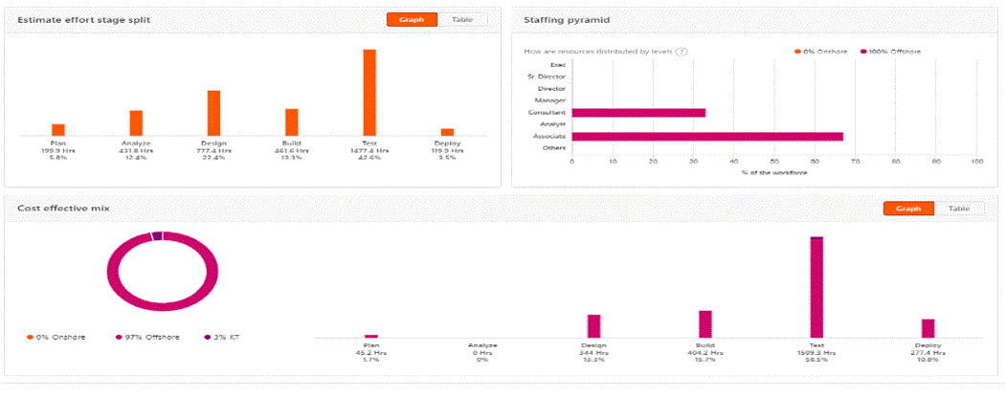
OPTIONAL
Effort Estimate & Staffing Pyramids
<add link to AEP>
Slide Purpose: This slides provides for an example of how to present the basis of the effort estimation, and associated workforce mix, for the scope of work.
Key Note:
The effort estimate should incorporate a clear view of the work breakdown structure, the core tasks and roles required, type and timing of key outputs or outcomes etc.
Instructions
This is an OPTIONAL slide which you may include at your discretion
Take a screenshot of the ‘Summary’ page within the AEP and add a link to the AEP within the slide; noting that only those individuals added as ‘reviewers’ to the AEP will be able to view the actual estimate
Add key notes, as appropriate, in text formatted <like this>
Delete this message upon completion
Key notes:
<add text>
<add text>
<add text>
<add text>
<add text>
Sticky note to use during solutioning

Slide 14
Indicative High Level Schedule
OPTIONAL
 | Avanade activity
 | Client activity
 | Key milestone
 | Work Product
Slide Purpose: Provides an overview of the project schedule. It outlines the key activities / milestones as a schedule. Highlight Client dependencies, outputs (including deliverables / work products) and key milestones.
Instructions:
This is an OPTIONAL slide which you may include at your discretion
It is NOT necessary when providing a ROM
When used, provide an indicative project schedule that outlines our delivery approach and timeline – do NOT provide specific dates
Populate all text formatted <like this>
Delete this message upon completion
1
Dependency
Note: This schedule provides indicative timeline ONLY. It will change based on overall solution and delivery approach and is to be validated as part of overall solution and during mobilization.
Deliverable
Track | W1 | W2 | W3 | W4 | W5 | W6 | W7 | W8 | W9 | W10 | W11 | W12 | W13 | W14 | W15 | W16 | W17 | W18 | W19 | W20
Insert track
Insert activity
Milestone
1
Insert activity
Work Product
Sticky note to use during solutioning
NOTES:
<insert any key items that you wish to call out regarding the delivery approach or timeline, e.g. Agile / iterative delivery approach, any dependencies that must be fulfilled before we can start, any assumptions that have been factored in with regards to vacation, freeze periods, deliverable review and approval durations, client availability, etc>
ETA slide

Slide 15
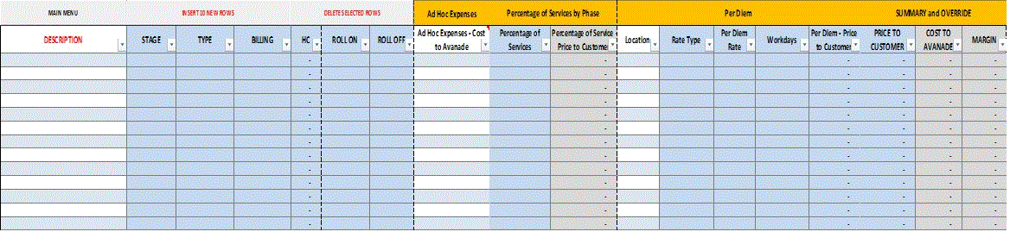
Expenses
OPTIONAL
Slide Purpose: Provides for an overview of how travel costs, connectivity, licenses and other expenses are being accounted for.
Instructions:
Optional slide as reviewers can source detail behind prior overview slide directly from DPM
Copy and Paste from the DPM ‘Reimb-HW-SW-Other Costs’ tab
Tip: Hide columns in the DPM that have no value if you need to get more space.
Delete this message upon completion
Sticky note to use during solutioning

Slide 16
Solution Blueprint Technology or Application or Security Architecture
MANDATORY
Slide Purpose: Provides for an overview of the technical Solution Blueprint, e.g. infrastructure, security, application architecture
Key note: A solution Blue
Instructions:
This is a mandated slide for fixed fee deals; in cases where a solution blueprint is not needed, please capture within your ‘Estimation Basis – Scope of Work’ summary
Please refer to the ADF or the offering Solution Guides for samples and templates.
Populate all text formatted <like this>
Delete this message upon completion
<Insert the technical architecture diagrams: Development, Execution, Operations>
Sticky note to use during solutioning
ETA slide

Slide 17
MANDATORY
Work Products & Deliverables
Slide Purpose: Lists the work products and or deliverables that need will be produced by Avanade under the scope of work.
Key Note:
A Work Product is a document that does not require any review or approval by the client, e.g. a project status report, test close report. A Deliverable is a document that the client must review and approve in order to move forward, e.g. a technical design document, a requirements definition document.
Instructions:
Do NOT delete this slide under any circumstances
Populate all text formatted <like this>
Ensure you detail the acceptance process against which any Deliverables will be assessed
Delete this message upon completion
Title | Description | Format | Any Acceptance Criteria | Type
<insert title - succinct> | <insert SMART description – sufficient detail to accurately describe what the document will contain, its format, its size etc.> | <document format> | <the specific criteria against which a Deliverable is reviewed and validated> | <WP/D>
Acceptance Process for Deliverables
<provide the key terms of the acceptance process that will be used to approve any Deliverables>
Sticky note to use during solutioning
ETA slide

Slide 18
Payment / Contract Milestones
MANDATORY
Slide Purpose: Provides for an overview of how the payment profile maps to the solution phases/stages and/or related work products and Deliverables.
Instructions:
Do NOT delete this slide under any circumstances
Where no Work Products or Deliverables are linked to a Milestone state ‘NA’
Check the payment profile is aligned with the DPM ‘ODE Output’ tab.
Populate all text formatted <like this>
Delete this message upon completion
# | Milestone | Description | Linked Work Products | Linked Deliverables | Date Due | Invoice Value (exc. VAT)
1 | <Name of Milestone> | <What phase/stage of the solution delivery does that fall in, and does the milestone signify phase/stage completion?> | <Link any Work Products linked to this Milestone> | <List any Deliverables linked to this Milestone> | <What is the Target Due Date for the Milestone?> | < Invoice amount?>
2
3
4
5
6
7
8
 |  |  |  |  | Total | <Total value>
Sticky note to use during solutioning

Slide 19
MANDATORY
Key External Dependencies/Obligations
Slide Purpose: Provides an overview of the key Client dependencies and associated obligations.
Key Note:
Dependencies are items that could materially impact the project schedule and activities if they do not happen or do not happen within the planned timeframe. Dependencies must be stated as a clear obligation on one party within the SOW, and can only be changed in delivery through a contractual change request.
Instructions:
Do NOT delete this slide under any circumstances
Populate all text formatted <like this>
Delete this message upon completion
# | Dependency | Impact | By When | Obligation With | Comments
1 | <insert dependency description and what obligation are we expecting to be provided / done and by whom> | <describe the impact/consequence of the dependency not being completed, or completed on time> | <detail timeline – by when must the dependency be in place> | <identify who owns the dependency – client or client third party> | <insert notes from QAD review>
Sticky note to use during solutioning
ETA slide

Slide 20
MANDATORY
Key Risks
Slide Purpose: Provides an overview of the top risks in descending order and the tangible mitigation actions that are being taken against or have been incorporated into the solution.
Key Note:
A risk is something that is yet to happen, and represents something that could adversely impact a project and or estimate. Any risk mitigation actions should be captured and tracked in a risk control log, and explicitly detail where the risk is being, or will be, managed e.g. within the Solution Plan, the contract, the sourcing approach, delivery etc.
Instructions:
Do NOT delete this slide under any circumstances
Focus on the key risks that could materially implicate the accuracy of the estimate and or Client expectations.
Populate all text formatted <like this>
Delete this message upon completion
# | Risk | Consequence | Mitigation Action(s) & Date | Impact | Probability | Owner | Comments
1 | <insert risk title - succinct> <insert risk description – what is the potential problem?> | <insert consequence – what happens if the risk is not resolved> | <detail mitigation – what steps are being taken to avoid the risk occurring and by when do they need to take place> | <H / M / L> | <H / M / L> | <identify who owns the risk mitigation steps> | <insert notes from QAD review etc>
Sticky note to use during solutioning
ETA slide

Slide 21
MANDATORY
Key Assumptions
Slide Purpose: Provides an overview of the key assumptions i.e. statement that is considered to be true but has yet to be verified (either within Avanade or with the client, as applicable).
Key Note:
By the time the SOW is written, there should be no assumptions remaining – they should be moved to 1) Scope/out-of-scope items; 2) Client obligations or 3) Delivery Approach within our scope of work definition.
A verified assumption should be noted and guidance provided on where it has moved to i.e. scope, obligations or delivery approach.
Instructions:
Do NOT delete this slide under any circumstances
Populate all text formatted <like this>
Delete this message upon completion
# | Assumption | Verification | Impact | Owner | Comments
1 | <insert assumption description - succinct> | <insert verification method – how will the assumption be verified> | <H / M / L – impact if assumption proves incorrect> | <identify who owns the verification action – Client or Avanade> | <insert notes from QAD review and verified assumption outcome>
 | e.g. Standard acceptance procedure for Deliverables as outlined in the SOW, i.e. 2 Client review cycles, each 5 days in duration | e.g. Confirm with the Client that the process and duration assumption is correct | e.g. High | e.g. Avanade
Sticky note to use during solutioning
ETA slide

Slide 22
Pre-Contracting Action List
MANDATORY
Slide Purpose:
Used to provide an overview of the critical items that need to be confirmed or completed before Avanade can sign a contract. These could be key dependencies, our proposed approach or specific risks that need to be discussed. These are the items that keep you up at night!
Instructions:
This is a mandated slide for fixed fee and non-standard T&M solutions
Populate all text formatted <like this>
Consider how these items may implicate your ability to attain Solution or Deal approval, ahead of any review.
Delete this message upon completion
List of items(risks, assumptions, client obligations etc) required to be confirmed with the client and documented PRIOR to contract signature
No. | Item | Owner
1 | <Example: Client agrees to the overall timeline, scope and approach of this phase and the program as a whole.> | <e.g. Deal Owner>
2 | <Example: Client has confirmed that all GDPR, legal, security, export control and any other compliance restrictions on content and applications has been approved.> | <e.g. Deal Owner>
3 | <Example: Client agrees Data Transfer Agreement and Data Protection Protocols for all related data being provided to Avanade> | <e.g. Deal Owner>
4
5
6
Sticky note to use during solutioning

Slide 23
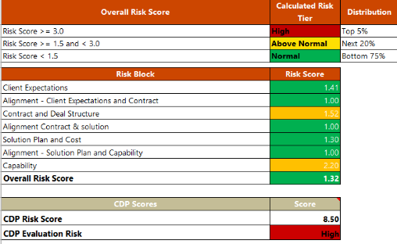
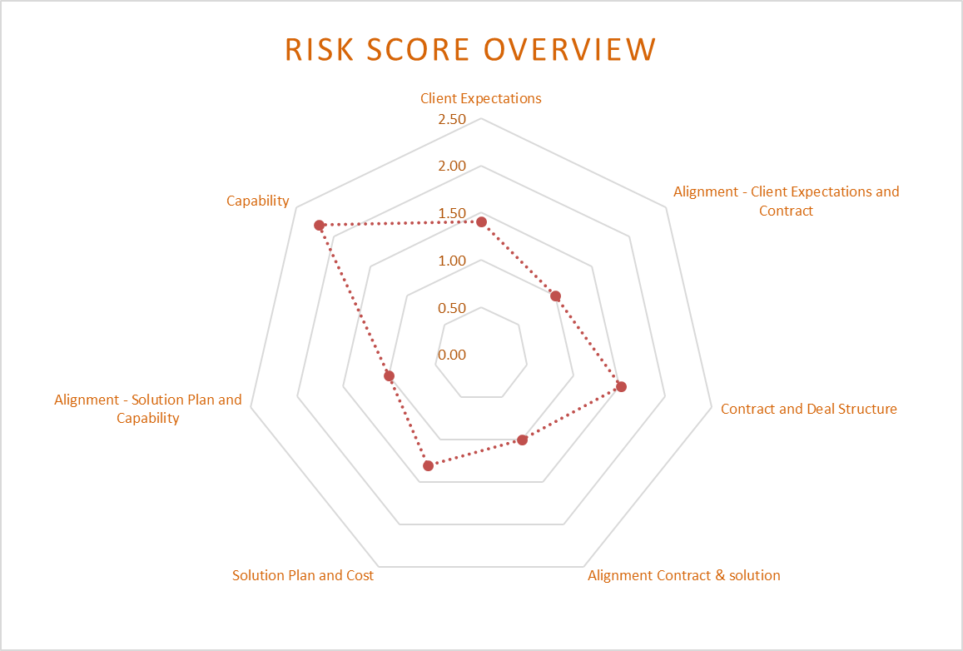
Opportunity QA Risk Assessment Risk Profile
OPTIONAL
Slide Purpose: Provides for an overview of the Risk Profile as established through completion of the QA Risk Assessment; where applicable.
Key Notes:
The Opportunity QA Risk Assessment is required for deals per QA Policy 0017, but recommended for all deals with an SA assigned
Instructions:
This is an OPTIONAL slide which you may include at your discretion
Go to the ‘Risk Profile’ tab and unprotect the sheet. Copy and paste the Overall Risk Score table and the Risk Score Overview spider diagram.
Use the ‘Notes’ section to indicate the key points raised by the Opportunity QA Director as input to the Solution Plan Review.
Populate all text formatted <like this>
Delete this message upon completion
Notes
<Provide any commentary required on the QA Risk Assessment results>
Sticky note to use during solutioning

Slide 24
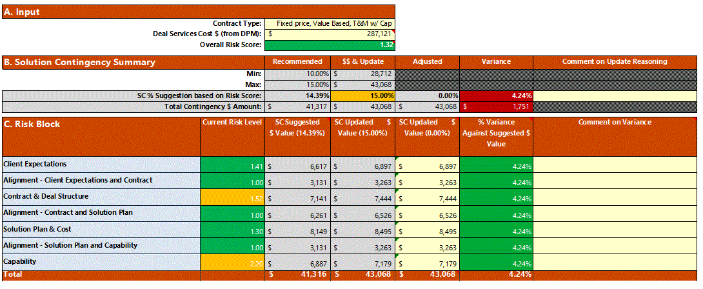
Opportunity QA Risk Assessment Solution Contingency
OPTIONAL
Slide Purpose: Provides for an overview of the Solution Contingency amount computed and the detailed risk allocation against the risk block model.
Key Notes:
The Opportunity QA Risk Assessment is required for deals per QA Policy 0017, but recommended for all deals with an SA assigned
Instructions:
This is an OPTIONAL slide which you may include at your discretion
Go to the ‘SC Calculator-SI’ tab and unprotect the sheet. Copy and paste the table.
Use the ‘Notes’ section to indicate the key points raised by the Opportunity QA Director as input to the Solution Plan Review.
Populate all text formatted <like this>
Delete this message upon completion
Notes
<Provide any commentary required on the contingency applied to the project especially if it is different from what is recommended from the QA Risk Assessment>
Sticky note to use during solutioning

Slide 25
CDP Risk Assessment
MANDATORY
Slide Purpose: Provides an overview of the solution approach to Client Data Protection.
Key Note:
The CDP Risk Assessment is required for all direct and Avanade RBE engagements. The SA must ensure that the nature of, and type of access to, Customer Data required for the project is appropriately considered in respect of commercial terms, delivery requirements and cost impacts for the proposal
Instructions:
Do NOT delete this slide under any circumstances
Work with the BD / Deal Owner who is responsible for completing the CDP Risk Assessment in C365.
Populate all text formatted <like this>
Delete this message upon completion
<Provide any commentary required on the CDP Risk Assessment results>
What is the CDP Risk Score? | <H/M/L> | <who completed the CDP risk assessment>
Does Avanade have access to Personal Data? | <Yes / No> | <describe what data Avanade has access to, and whether legal are involved>
Has the nature of Avanade access to Customer Data been established? | <Yes / No> | <describe the nature of access Avanade will have to Customer data>
Has implementation of CDP Controls been planned? | <Yes / No> | <describe the basis for the CDP plan to be implemented e.g. existing client CDP plan, short form plan, Accenture CDP plan etc.>
Has implementation of Project/Customer Controls been planned? For example client specific onboarding/training requirements. | <Yes / No> | <describe the plan for both project and client mobilization, including effort (hours) allocated>
Is there a Data Privacy/Protection regulation impact? | <Yes / No> | <overview what the regulation impact is, and steps to mitigate impact>
Have CDP hours been included in the effort estimate? | <Yes / No> | <state the hours included and how they will be distributed>
Sticky note to use during solutioning

Slide 26
OPTIONAL
Project Organization
Slide Purpose: Provides for a representation of Avanade’s understanding of the organisation structure. The project organization chart does not need to include every role to be staffed, just the core roles.
Instructions:
Adjust the organisation chart as appropriate, noting that where “Accenture is the RBE”, the top level/s of the diagram should state Accenture resources.
If ATC is involved, make sure lead roles offshore, and the governance between onshore and offshore are shown
Ensure any Avanade roles represented are aligned with the ‘Estimate’ slide
Delete this message upon completion
Onshore Lead
Name
Factory Lead
Name
DMO
Name
Resource 1
BC<x>
Resource 2
BC<x>
Resource 3
BC<x>
Resource 1
BC<x>
Resource 2
BC<x>
Resource 3
BC<x>
Client Lead
Name
Client Resource 1
Name
Client Resource 2
Name
QA
Name
Project Manager
Name
Delivery Lead
Name
Legend
Avanade Onshore
Avanade Offshore
Client Resources
Sticky note to use during solutioning
ETA slide

Slide 27
Project Leadership & Critical Roles
OPTIONAL
Slide Purpose: Provides an overview on the core Avanade leadership team for the Project, including their history in respect of the client or in comparable solutions.
Instructions:
This is an OPTIONAL slide which you may include at your discretion
It is NOT necessary when providing a ROM
Populate all text formatted <like this>
For ‘Allocation’ state the % effort allocated as a factor of the overall staffed hours; or provide the hours per week/month
Delete this message upon completion
Delivery Leadership Team
Role | Name | Allocation | Engagement History
Client Executive Lead | <Name> | <X%> | <Example: Orange Client account lead at Client A>
Overall Delivery Lead | <Name> | <X%> | <Example: Delivery Lead for $Xm Digital engagement managed at Client A>
QA Director | <Name> | <X%> | <Example: QA at Client X, Delivery lead at Client Y>
GDN Delivery Lead | <Name> | <X%> | <Example: GDN (India) Delivery Lead for $Ym AX engagement managed at Client B>
Market Unit / Technology Architect | <Name> | <X%> | <Example: Led technology team at Client C, large/complex .Digital, CRM to AX integration>
Critical Roles
Role / Skills | Name | Sourcing Strategy
<Example: Agile Scrum Master> | <Name> | <Document the resourcing approach in respect of FTE vs contractor vs third party, and associated core considerations on timing, cost etc>
Sticky note to use during solutioning
ETA slide

Slide 28
Role and Responsibilities - Solution RACI
MANDATORY
Slide Purpose: This slide outlines the RACI Matrix to identify Accountability and Ownership, and to highlight which workforce is primarily responsible for the major activities within the project.
Instructions:
Do NOT delete this slide under any circumstances
Update the Activity/Task items and associated RACI classification as appropriate for your project, noting:
There should only be one accountable party for any Activity/Task
Parties can be added or removed to the table, as appropriate
RACI tables should be incorporated into both proposal and SOW materials
Delete this message upon completion
Activity/Task | Client | Avanade Onshore | Avanade ATC | 3rd Party
Firewall Changes / Service Accounts / CRs | R | AC
Provisioning of servers in AHP | I | AC | I | R
Installation of ShareGate & Metalogix | I | RA | C
Installation of SharePoint Insights Infrastructure | I | RA | C
Installation of SharePoint Insights server software | I | A | R
Installation of SharePoint Insights Agents | C | A | C | R
Running SharePoint Insights Reports | C | A | R
Building As-IS Analysis | C | RA | C
Site selection for PoC Migrations | A | R | C
Site Migration + monitoring of process | I | A | R
Site Migration – Issue Analysis (not remediation) | I | A | R
Site Migration – UAT | RA | C | I
Site Migration Overview Report | C | RA | C
Creation of Test Approach | I | R | A
Creating of PoC Test Scripts | I | AR | C
Execution of Test Scripts | I | A | R
PoC Analysis and Exit Report | I | A | R
Create build guide | I | AR | C
Create Questionnaire | I | AR | C
Application Report | I | AR | C
SharePoint Road Map and Design | I | AR | C
Exec Summary | I | AR | C
Key
R | Responsible: Those who do the work to achieve the task. There is typically one role with a participation type of Responsible, although others can be delegated to assist in the work required.
A | Accountable: Sometimes also knows as Approver or final Approving authority. This is the one ultimately accountable for the correct and thorough completion of the deliverable or task. An Accountable must sign off (Approve) work that a Responsible provides. There must be only one Accountable specified for each task or deliverable.
C | Consulted: Those whose opinions are sought; and with whom there is two-way communication.
I | Informed: Those who are kept up-to-date on progress, often only on completion of the task or deliverable; and with whom there is just one-way communication.
Sticky note to use during solutioning

Slide 29
OPTIONAL
Assets and Tools
Slide Purpose: Provides an overview of any Avanade or third-party tools or assets that are included in the solution.
Key Note:
Solution Architects must consider assets and tools, including associated warranty and license requirements and costs. Technical Assets can be found at InnerSource.
Solution Architects should review the Solution Guides associated with the offering to list the delivery tools together with the assumed impact.
If you are using an Asset it is your responsibility to ensure the asset has been examined for export compliance and has an ECATT record. See the InnerSource asset page for details.
If using OpenSource software it is your responsibility to ensure the licence agreement is acceptable and that all obligations pertaining to the OSS licence agreement are fulfilled. See link for more information: https://ossgovernance.accenture.com
Instructions:
This is an OPTIONAL slide which you may include at your discretion
Populate all text formatted <like this>
Delete this message upon completion
During solutioning, the following Assets have been examined for export compliance and have an ECATT record:
Asset | Impact | Value
<Kinect Accelerator> | <Provides baseline functionality for applications Kinect features> | <Describe the value proposition in respect of the benefit(s) this asset provides to the client>
During solutioning, the following Tools will be used:
Tool | Impact | Value
<VS Coded UI Testing> | <Provided automated testing and regression testing of the significant UI portion of the application> | <Describe the value proposition in respect of the benefit(s) this asset provides to the client>
<e.g. Apache webserver> | <e.g. Opensource software to serve web content>
<e.g. MEP>
<ScrumPlus process template>
Sticky note to use during solutioning
ETA slide

Slide 30
Appendix A – Supplementary slides
Additional slides, including examples of mandatory/optional slides, to use if required.

Slide 31
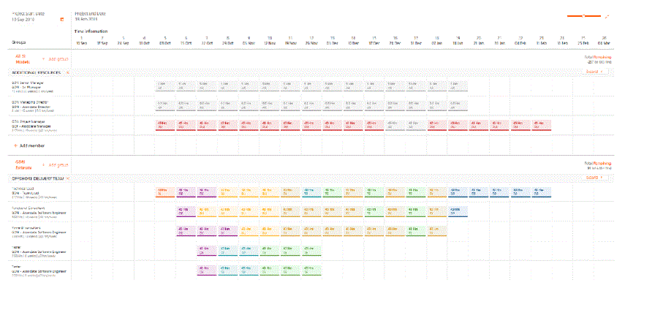
Staffing & Effort Estimate by Week View - AEP
Example
Comments:
…
…
…

Slide 32
Mobilization Considerations/Lead Times
Example
Aspect | Typical Lead Time
Hardware Procurement (RAM and HDD upgrades, Laptop rentals, Server rentals, and so on if required.) | 6-8 weeks
Security Approvals for VPC (If any non-standard Avanade software or VPCs are to be installed on the developer, desktops must undergo a TPRA audit.) | 2-4 weeks
Security approval for separate Domain for Active Directory (if required) | 2-4 weeks
GDN Resource Mobilization (For external sourcing channel, including contracting.) | 10-12 weeks
Business VISA Lead time (For resources traveling from <GDN Location> to US.) | 4 weeks (Typically) 6 weeks (considering the vacation period)
L1 VISA Lead time (For resources traveling from <GDN Location> to US. Condition is that the resource should have worked in Avanade for at least 1 year at <GDN Location>.) | 6 – 8 weeks
Secured bay setup lead time | 6 -7 weeks

Slide 33
Infrastructure Requirements and Cost Elements
Example
Hardware | Test environment will be provided by the client An instance of development server for integration testing will be provided by the client. The following desktop upgrades will be applied, per project’s need: 3GB RAM + 120GB Hard Disk Four Servers to be setup at the Avanade Chicago ATS Network (1 BTS Integration Server, 1 SQL Integration Server, 1 Moss Integration Server, I TFS Build Server) for development and testing. GDN Developer Workstation will be connected to Avanade Chicago ATS network via VPN with High Speed Redundant Connectivity. Lead time applicable for any hardware procurement at GDN. Onshore will provide the needed H/W configuration.
Software | Licenses that need to be procured will be charged to the project WBS. Otherwise, the client will provide. Project-specific VPC will be provided by the onshore team, and will not require any further configuration from IDC. This will be deployed in the GDN desktops for development, and will require TPRA audit approval. There will be three different developer VPC/VM images. Data Collection Developer VM Image (Win2k8, BTS2009, SQL2008, VS2008) SharePoint Developer VM Image (Win2K8, SharePoint 2007, SQL 2008, VS2008,) DB/BI Developer VM Image (Vista, SQL Server 2008 Integration, Analysis & Reporting Services, VS 2008)
Connectivity | 1.5 Mbps ACN bandwidth for data connectivity for work stream. 15 hrs/week of international voice. However, the preferred first line of connectivity would be Office Communicator and Live meetings. GDN team will have specific URLs or ports opened to access the external interfaces and data sources like Yahoo, Google for development and integration testing.
Security | Required
Other costs | Laptop for Travelling resources. Project has planned to have TL's from GDN to travel to NYC for two weeks during the design phase. Business Visas are planned for and costs have been budgeted. The following roles will need to travel to the US from 1/11/2012- 1/22/2012: Application1 (1 BTS Lead , 1 SharePoint Lead) , BI (1 DB Lead, 1 SSIS Lead) . GDN PM will also travel along with these TLs for 2 weeks. Seat cost at GDN for two onshore resource for 2 weeks (Tentative budget). Training costs, if needed, are budgeted (BI, MOSS, BizTalk, Specific Testing skills).

Slide 34
Scope - Estimating Basis
Example
Inventory / Components
Area | Total Count | Simple | Medium | Complex
Total No of Pages | 3,395 | 2,538 | 634 | 223
No of Custom Page Layout | 156 | 76 | 46 | 34
Application workflows | 30 | 12 | 7 | 11
No of Forms | 308 | 142 | 86 | 80
No of Interfaces | 95-135 | 28 | 32-64 | 24-42
No of Business Logic Components | 232 | 122 | 59 | 51
No of Business Entities | 241 | 45 | 150 | 46
Total No of Tables | 307 | 163 | 101 | 43
Stored Procedures | 614 | 326 | 202 | 86
No of Batch Programs | 78 | 32 | 18 | 28
Security and SSO | 2 | 1 | 1 | 0
Forms Authentication Implementation | 1 | 0 | 0 | 1
Custom Webparts | 59 | 22 | 28 | 9
Search Configurations | 78 | 34 | 28 | 16
Authorisation components | 23 | 23 | 0 | 0
Deployment Scripts for packages | 87 | 36 | 36 | 15

Slide 35
Key Workstream Tasks by Stage
Avanade Business Analysis workstream
Avanade Technical workstream
Y
In Scope
Example
-
Out of Scope
Avanade Experience Design workstream`
Avanade Test workstream
Avanade Delivery Management workstream
Customer workstreams
ENVISION & PREPARE
CONSTRUCT & RESOLVE
ACCEPT & RELEASE
?
Plan & Mobilize Program
?
Conduct User & Stakeholder Research (inc Design Thinking workshops)
?
Create Brand Guidelines
?
Conduct Sprint Planning (agree Sprint Backlog)
?
Execute UAT
?
Gather / Review Functional Requirements
?
Define Personas & / Or Scenarios
?
Review proposed PBIs and Refine Completion Criteria
?
Conduct Daily Standups (resolve blockers)
?
Manage & Monitor UAT
?
Gather / Review Non-Functional Requirements
?
Analyse Competition / Market
?
Content Editor Training Planning & Preparation
?
Conduct Sprint Retrospectives (review Sprint velocity)
?
Execute End-to-End Performance Tests
?
Define Content Taxonomy
?
Define Information Architecture
?
Create Akumina Code
?
Conduct Sprint Reviews (including ‘early view’ testing
?
Execute Security Tests
?
Define Product Backlog & PBIs
?
Create Wireframes
?
Triage & Resolve System Test Defects
?
Document DevOps Build Guide
?
Triage & Resolve UAT Defects
?
Define Enterprise Architecture & Document Solution Blueprint
?
Conduct User Testing
?
Create System Test Scripts (Sprint preparation)
?
Prepare Deployment Guide & Release Notes
?
Resolve In-Application Performance Defects
?
Define Application’s Technical and Environments Architecture
?
Define Page Specification
?
Execute System Test (in Sprint)
?
Release & Smoke Test Product Increment
?
Resolve In-Application Code-Level Security Defects
?
Set up Avanade Environments Architecture (including software installations)
?
Define Creative & / Or Brand Strategy
?
Manage & Monitor System Test
?
Define UAT Test Plan
?
Retest UAT Defects
?
Document Technical Architecture Design (including components)
?
Create Visual Design Compositions
?
Create In-Application Performance Test Scripts
?
Prepare for UAT Test (Scripts, Data, Users)
?
Execute Performance Tests
?
?
Build High-Fidelity Click-through Prototype
?
Execute In-Application Performance Tests
?
Define End-to-End Operational Performance Test Plan
?
Conduct Content Editor Training
Define DevOps Process & Tooling
?
?
Create Front-End Code & Conduct UI Testing
?
Content Readiness Preparation
?
Prepare for End-to-End Operational Performance Test (Scripts, Data, Users)
?
Create Content
Set up DevOps Process & Tooling
?
Content Readiness Planning
?
Create Visual Design Style Guide
?
Business Change Plan Execution & Management
?
Define Security Test Plan
?
Business Change Plan Execution & Management
?
Business Change Planning & Preparation
?
Define System Test Plan
?
Prepare for Security Tests
?
Set up Customer Environments Architecture (including software installations)
?
Prepare for System Test (Scripts, Data)
Notes:
Areas of Potential Conflict
Areas where Agencies or XD has fell short
Areas where Avanade technology has fell short
Areas for improvement

Slide 36
Project Meetings Governance – Purpose & Rhythm
Example
Project Steering
To provide strategy, decisions, oversight and coherent management of the projects goals throughout the project’s duration
Business Sponsor Other Key Stakeholder
Engagement Lead as req’d Delivery Lead as req’d
Monthly
Design Council
To review progress of experience design activities. Facilitates provision of feedback from design stakeholders and mechanism for alignment on design approach across these stakeholders
Product Owner Project Manager Other Key Stakeholders
Experience Design Lead Delivery Lead Key individuals as req’d
Weekly, 1-2 hours
Project Status
To assess project status and coordinate project activities, dependencies, risks and issues
Product Owner Project Manager
Delivery Lead Scrum Master Key individuals as req’d
Weekly, 1 hour
PURPOSE
CUSTOMER
AVANADE
RHYTHM
36
Notes:
Purpose: This slide is for use in the Opportunity QA Review and the Customer Proposal to provide clarity on project meeting governance and rhythm. This information will be included in the SoW.

Slide 37
Sprint Meetings Governance – Purpose & Rhythm
Example
Sprint Planning
A planning session to: Decompose PBIs into tasks Estimate PBI story points Log any sprint assumptions or dependencies Finalise the Sprint Backlog
Product Owner Project Manager
Delivery Lead Scrum Team
Sprint Start, 2-4 hours
Daily Scrum
A short, focussed planning & progress review session: What have I completed? What will I complete by next stand-up? What impediments are there to my progress?
Product Owner (as req’d)
Scrum Team
Daily during Sprint, 15 mins
Sprint Retrospective
An end-of-sprint meeting to: review progress and velocity assess working practices identify activities to drive continuous delivery improvements
Product Owner Project Manager
Delivery Lead Scrum Team
Sprint End, ~1 hour
Sprint Review
A meeting to demonstrate the Product Increment to key stakeholders and elicit feedback
Product Owner Project Manager Champions
Delivery Lead Scrum Team
Sprint End, 1-2 hours
PURPOSE
CUSTOMER
AVANADE
RHYTHM
Notes:
Purpose: This slide is for use in the Opportunity QA Review and the Customer Proposal to provide clarity on Sprint meeting governance and rhythm. This information will be included in the SoW.

Slide 38
Issue Escalation Procedure
Example
In the event a party determines it is not getting adequate resolution to an issue or problem, which may have material impact on the successful performance of the project, the following represents the escalation paths to be followed:
Customer
Avanade
The issue or problem will initially be brought to the attention of the Avanade Delivery Lead and the Customer Project Manager.
If the above parties are unable or unwilling to address an issue or problem, it may next be taken directly to their supervisors - the Avanade Engagement Lead and the Customer Programme Lead.
If, after ten (10) business days, the issue or problem remains unresolved, a party may insist the project issue or problem be raised to a senior executive (TBA for Avanade, TBA for Customer).
Name
Delivery Lead
TBA
Project Manager
Level 1 escalation
Name
Engagement Lead
TBA
Programme Lead
Level 2 escalation
Name
Role
Name
Role
Level 3 escalation
Notes:
Purpose: This slide is for use in the Opportunity QA Review and the Customer Proposal to provide clarity on the escalation procedure and the contact points within that procedure. This information must be included in the SoW.

Slide 39
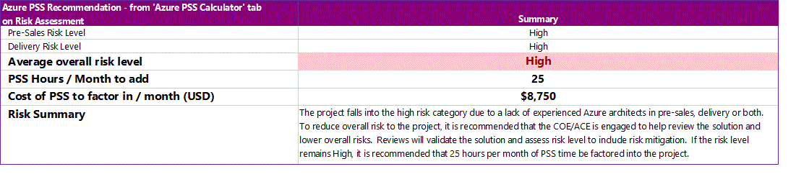
Azure PSS Coverage
Sticky note to use during solutioning
Slide Purpose: Provides for an overview of the risk associated to the use of Azure within the solution, considering both the expertise of the solutioning and proposed delivery teams.
Instructions:
Mandatory slide where Azure is part of the solution
Complete the Azure PSS Coverage Calculator, located in the final tab of the QA Risk Assessment Template
Copy and paste cells A23:C29
Populate all text formatted <like this>
Delete this message upon completion
Notes
<Describe how PSS has been covered within solution plan>

Slide 40
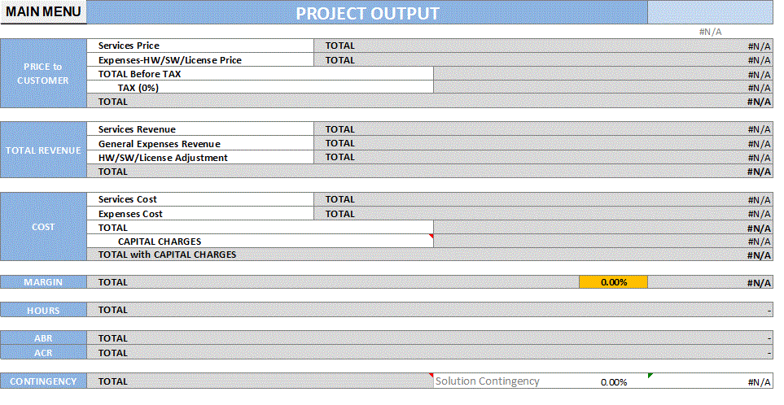
Deal Pricing Model
Sticky note to use during solutioning
Slide Purpose: Provides for an overview of the solutions service cost, expense cost, contingency, cost of capital, pricing, margin and projected revenue.
Instructions:
Do NOT delete this slide under any circumstances
Copy and Paste the Project Output view from the DPM ‘Project Output’ tab (H2 to B407)
Populate all text formatted <like this>
Note: Payment term is found in the DPM in cell C31 of the ‘ODE output’ tab
Delete this message upon completion
Payment Terms: <Enter term>

Slide 41
Appendix B- Associated Policy & Process

Slide 42
Core Reference Materials
Policy Area | Overview | Reference Materials
Managed Delivery | Provides an industrialized approach to delivering solutions to our clients in a consistent, structured and disciplined manner. | Homepage Policy 5005
Solution Contingency | A cost established during the Opportunity phase, to be managed during the Delivery phase. It is intended to cover costs when specific project risks materialize which could not be mitigated. | Homepage Company Guidelines
Target Margins | Floor and Target margins by Offering, Type of Work, and Area. Note: In C365 these values are presented in the UI. | Policy 5003 (Floor Margins tab)
Required Documents | Guidelines by Region, Sales Motion, and Deal Value for core Solution artefacts, governance and associated controls. | Policy 5003 (Required Documents tab)
SA & QA Assignment | Guidelines by Region, Sales Motion and Deal Value for mandated assignment of SA & QA | Policy 5003 (SA_QA Matrix tab)

Slide 43
Core Policies
Policy | Name | Context
Policy 0017 | Global Quality Assurance | Provides Quality & Risk Management requirements. Make sure QA Effort is included on Additional Resources based on guidance
Policy 0055 | Performing Services in New Countries and High Risk Countries | This policy sets forth the request, review and approval process for proposals for Avanade to pursue client projects where all or part of the Company’s services are anticipated to be performed in a country for which no Avanade entity currently exists.
Policy 0110 | Contracting-Global Policy | Defines the principles that govern the development, negotiation, and execution of Avanade’s contracts with clients.
Policy 0150 | Gifts, Meals, Entertainment and Travel | Provides clarity on anti-corruption laws.
Policy 0200 | Financial Ownership (Solution Contingency) | Solution Contingency, is money set aside within the deal financials for risks that couldn’t be mitigated in deal. Determined in Opportunity Risk Assessment Template and output in DPM.
Policy 0123 | Client Records Management | Describes what is required to manage Avanade’s Business Records and Temporary Documents related to Direct Agreements. Key deliverables are retained for legal purposes e.g. contracts
Policy 1254 | Restrictions on Doing Business with Certain Countries, Organizations and Individuals (Trade Controls) | Intended to ensure that sensitive and potentially dangerous items are not misused or allowed to fall into the wrong hands. Export Compliance questionnaire found in OMS. Link to: Trade Compliance Program, ECATT Tool
Policy 1327 | Business Intermediaries | Provides clarity on anti-corruption laws.
Policy 1431 | Data Management | Provides protection for Client’s confidential data. Effort to create CDP Plan and CDP training must be included in the effort and cost estimates. Link to: CDP Site
Policy 5003 | Global Solution Sign-Off and Deal Approval Matrix and Opportunity Management Solution Usage | Deal Review and Approval policy, including the matrix of required thresholds, approvers , documentation etc.
Policy 5005 | Managed Delivery Usage | Managed Delivery provides an industrialized approach to delivering solutions to clients and is required for certain deal types. Link to: Managed Delivery Portal
Policy 5006 | Signing Authority Policy | The purpose of this policy is to ensure that Company employees hold appropriate internal management authority when legally binding the Company.
Policy 5080 | Certain Compensation from Microsoft | This policy describes the type of compensation allowable to Avanade in support of client engagements.

Slide 44
Reference - Fixed Fee Delivery Questions
Fixed Fee Terms
What is the fixed schedule date? Limits? Penalties?
Scope |  |  | Deal Review Questions if ‘no’:
Are the client functional and non-functional requirements clearly defined? | YES | NO | Detail the gaps
Is there a formal change management approach to ensure Avanade is paid for out of scope work? | YES | NO | Detail the Change management approach
Acceptance and Issue Escalation |  |  | Deal Review Questions if ‘no’:
Are standard acceptance terms and conditions included in the contract for approving deliverables with a standard timeline? | YES | NO | Detail deviations from the standard terms
Is there a clear escalation process in the contract for all issues that may arise? Does the contract allow for joint review and decision making? With a time limit? | YES | NO | Detail the issue escalation approach
Staffing |  |  | Deal Review Questions if ‘no’:
Is a Full Time Delivery Lead budgeted? | YES | NO | Detail the how PM oversight is provided
Has the necessary resource availability been confirmed by all Avanade delivery locations? | YES | NO | Detail the staffing constraints
Avanade is sole provider of staff to the engagement? | YES | NO | Detail any Contractors and Third Parties. Detail their role, dependencies and risk
 |  |  | Do client resources fit the scope, skill set and geographic needs of the project

Slide 45
Classifications and Document Control – Highly Confidential Data
This document contains <Highly Confidential Data> per Avanade’s Data Management Policy.
Highly confidential data is very sensitive company data, client data, and personal data that is used for legitimate business purposes.
More information can be found on the Data Classification and Protection website including tools, templates, and training.
Mandatory Protection for Highly Confidential Data
Access | Access is limited to select individuals/groups that need it to perform their job duties. Access is enforced by encrypting the file using minimum 256-bit encryption before being shared or stored anywhere except Avanade workstations or secure repositories. Click here for the complete list.
Devices | Drive is encrypted to minimum 256-bit encryption; when disposal is necessary, physically destroy or securely overwrite when no longer needed.
Storage/Sharing | If highly confidential data will be leaving your workstation for any reason using a standard application (e.g., email, Skype, Yammer), it must be encrypted with the appropriate tools like Active Directory RMS or 7-Zip. File-level encryption is not required when sharing via a secure repository (e.g., uploaded into SAP, OM, OneDrive for Business, SharePoint site). Click here for the complete list.
Transmission | Company data and client data that is transmitted to or received from outside of Avanade must be encrypted (e.g., FTPS, SSL, HTTPS, TLS).
Retention | Company data: If retention is required per Policy 1413AVA: Corporate Records Management, contact your Functional Records Lead. All other company data should be retained for 3 years once template/document/record is no longer current, then securely deleted. Client data: If retention is required per Policy 0123AVA: Client Records Management, contact your Project Lead for more information. All other client data should be deleted at the end of an engagement if there is no business need.

